Slide 1
Project overview
Project Management System

Slide 2
Why this project?
This project is purposed to help organize a project’s information in one place for future reference.
The system also adds some team management functionalities like managing meeting, creating and managing tasks within a project

Slide 3
Progress
The development of all 2 parts of the project (frontend, backend) is going on simultaneously.
So far users can login into the system and see they projects/teams they are involved in
Users can also select a project to start working on it.

Slide 4
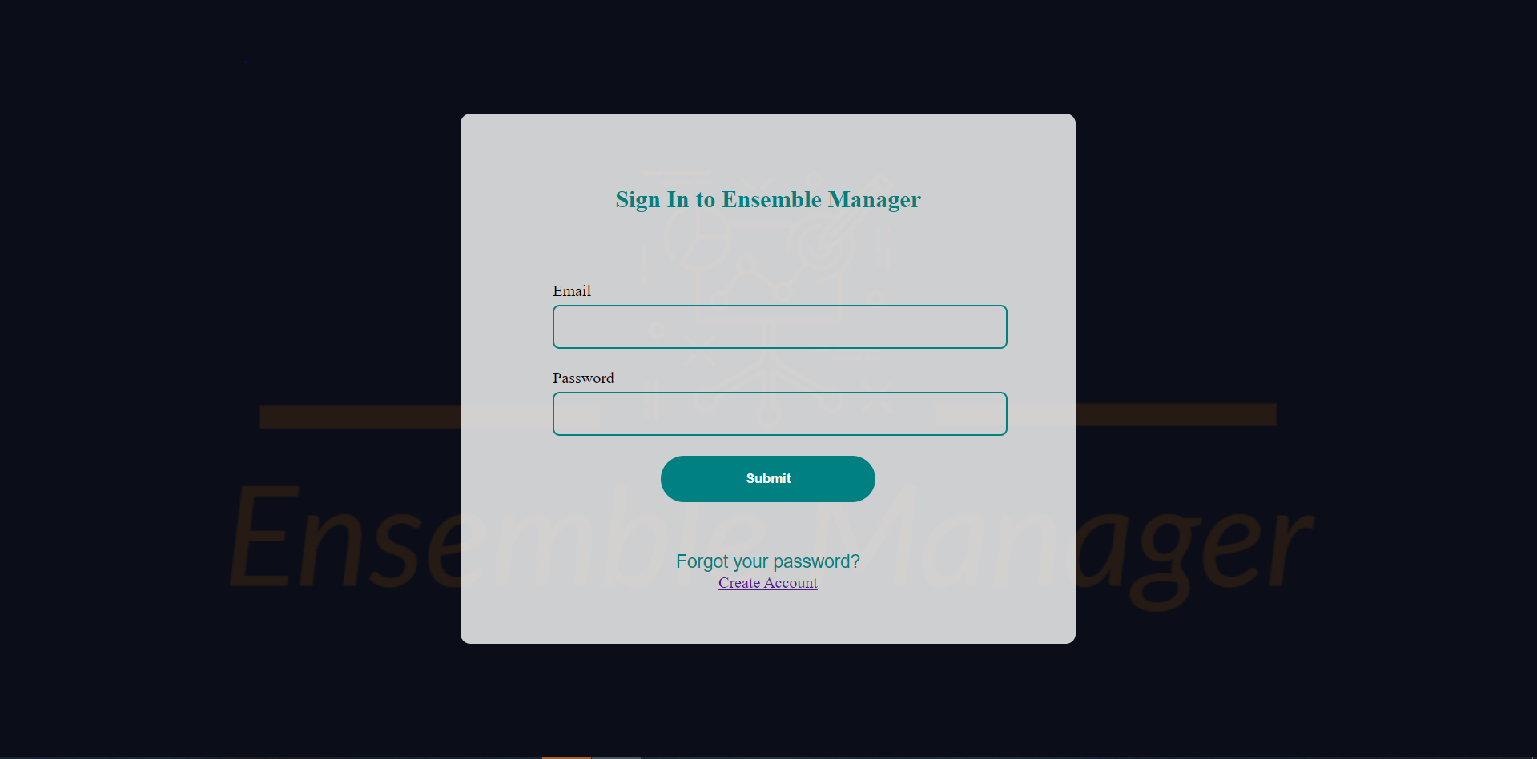

Slide 5
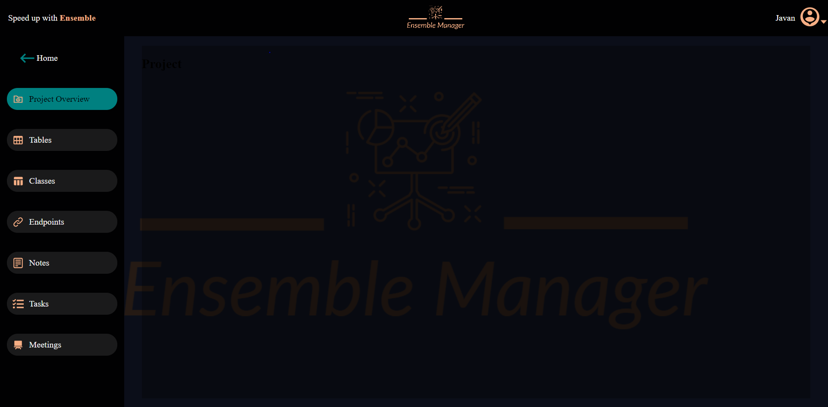

Slide 6
